Slide 1
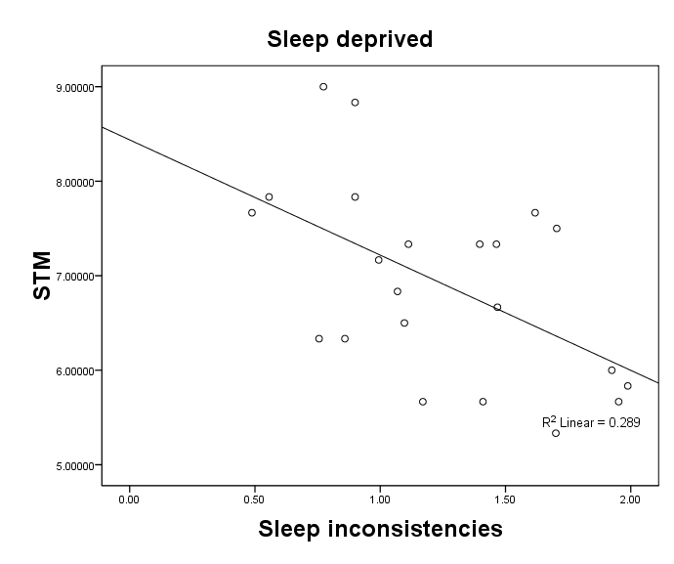
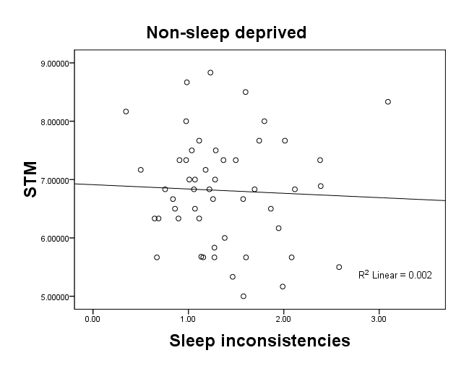
Cognitive Performance as a Function of Patterns of Sleep
Nicholas J. Ullrich III, St. Joseph’s College, New York
Abstract
The purpose of the present study was to examine the effect of sleep pattern variation (e.g., sleeping the same amount of hours each night versus sleeping a different number of hours each night) and chronic sleep deprivation on cognitive functioning. A sample of 74 undergraduates from a small private college were asked to keep a daily sleep log for one week. At the end of the week, they performed a series of cognitive computer tasks measuring their abilities of sustain attention and memory. A moderate negative relationship was found between sleep pattern and memory among chronically sleep deprived individuals indicating that sleep deprived individuals who get erratic sleep will suffer short term memory deficits.
Procedure
Ethical procedures followed APA recommendations. Participants completed the demographic form along with the sleep log one week prior to taking a cognitive assessment battery. During a single session, participants completed the Stanford Sleepiness Scale, the PEBL Psychomotor Vigilance Test, and the PEBL Digit Span.
Sleep Deprived vs. Non-Sleep Deprived:
Relations between Inconsistency in Sleep and Short Term Memory
Results
Descriptive statistics: Means, Standard Deviations, and Skewness
Introduction
Variable | M | SD | Range Potential | Range Actual | Skew
Sleep Variables
Total weekly sleep Sleep inconsistency Perceived sleep need Perceived tiredness | 52.15 1.33 7.63 3.05 | 7.13 .52 1.21 1.17 | na na na 1.00-7.00 | 33.00-71.17 .35-3.09 3.00-10.00 1.00-6.00 | .07 .79 -.64 .81
Cognitive Variables
Short term memory Attention deficits Over-reactive Correct responses | 6.85 10.93 3.57 106.46 | .95 13.38 3.11 14.76 | na 0.00-120.00 0.00-120.00 0.00-120.00 | 5.00-9.00 0.00-93.00 0.00-14.00 20.00-120.00 | .20 3.99 1.25 -3.66
Recent studies have shown that the majority of Americans are not getting the proper amount of sleep each night (e.g., 7 hours of sleep) (Banks & Dinges, 2007). Research shows that chronic sleep deprivation (CSD), that is accumulation of multiple days of inadequate sleep, can lead to a host of negative cognitive and physiological effects such as inattention, memory problems, and general sleepiness (Banks et al., 2007).
Few studies have examined the effects of sleep deprivation in natural settings. The research has also failed to fully explore the effects of recovery sleep over an extended period. In addition, the research also omitted to look at how variations in daily sleep amounts could alter the effects of CSD.
The purpose of the current study if patterns of chronic sleep deprivation observed in natural settings have different outcomes. It was hypothesized that the effects of CSD will depend on the patterns of sleep and the amount of total weekly sleep received. It was expected that participants who received at least 49 hours per week and that had low variation in daily sleep would perform best on cognitive assessments.
Among the sleep deprived participants, Pearson’s coefficient indicated a moderate negative relationship (r(22) = .54, p<.05) between Sleep inconsistency and STM. The effect was strong (R² = .29) in that Sleep consistency predicts 29% of the variability in short term memory. In contrast, their was no significant relationship between sleep inconsistency and short term memory in the none sleep deprived group.
Conclusions
The research suggest that that the effects of sleep deprivation including variation in patterns can be observed in natural settings (vs. laboratory settings). Sleep deprivation was not related to cognitive abilities, but rather the combination of sleep deprivation and erratic patterns was a significant predictor of cognitive abilitiesl For those individuals who were not getting their proper daily rest (i.e., less than 7 hours), getting a consistent amount of sleep each night was very important. Deficits in short term memory were found in sleep deprived individuals who had erratic sleep patterns. In contrast, for individuals who got the suggested amount of sleep (i.e., 7 or more hours), erratic patterns of sleep did not affect their short term memory.
Future research should explore why pattern variation only affects sleep deprived individuals and which other cognitive functions may be affected. Neurological research may shed light on which mechanisms are affected in sleep deprived erratic sleepers to produce cognitive deficits.
For all participants, perceptions of tiredness were not related to short-term memory or certain aspects of attention. However, sleep-deprived individuals who reported being tired were more likely to overreact when waiting for a event to happen (i.e., responded too quickly to stimuli). Further research needs to elucidate differences between actual deprivation versus subjective feelings of tiredness.
The sample was very homogeneous including primarily white females. The relations of sleep deprivation and cognitive functioning should be observed in more diverse populations.
Differences between Sleep Deprived and Non Sleep Deprived groups
Method
Variables | Sleep Deprived < 49 hours per week N=23 |  | Non-Sleep Deprived > 49 hours N=51 |  |  | t-test
 | M | SD | M | SD
Sleep Variables
Total weekly sleep Sleep inconsistency Perceived sleep need Perceived tiredness | 44.15 1.24 7.37 3.13 | 3.57 .44 .84 .39 | 55.77 1.36 7.76 3.02 | 5.08 .56 1.34 1.20 |  | -9.91* NS NS NS
Cognitive Variables
Short term memory Attention lapses Over-reactive Correct responses | 6.92 9.10 3.24 108.67 | 1.02 7.20 2.43 7.74 | 6.81 11.69 3.71 105.55 |  | .93 15.21 3.36 16.60 | NS NS NS NS
Participants
74 undergraduate students from a small private suburban college.
83% Caucasian (n=60)
85% female (n=62)
average age of 20.51, SD = 2.27
85% juniors or sophomores (n=61)
94% full time students (n=68)
89% were employed (n=64)
Average work hours were 23.68, SD = 8.11 hours per week.
Measures
Sleep Variables
Sleep Log: The sleep log was used to record the amount of hours the participants obtain over the course of one week. Participants indicate how much nightly sleep they had each day along with any time napping. Participants also indicated number of stimulating and depressant beverages consumed each day..
Stanford Sleepiness Scale:
What is your level of sleepiness at this moment?
1= Feeling active, vital, alert, or wide awake
2= Functioning at high levels, but not at peak; able to concentrate
3= Awake, but relaxed; responsive but not fully alert
4= Somewhat foggy, let down
5= Foggy; losing interest in remaining awake; slowed down
6= Sleepy, woozy, fighting sleep; prefer to lie down
7= No longer fighting sleep, sleep onset soon; having dream-like thoughts
Perceived Sleep Need:
How many hours do you believe you need to get a good nights rest and function well the next day?
Cognitive Variables
PEBL Perceptual Vigilance Task: Computer based measure of sustained attention adapted from Psychomotor Vigilance Task (Wilkinson & Houghton, 1982) and includes 3 subscales: (1) number correct, (2) number of attention lapses, and (3) number of too fast reactions .
PEBL Digit Span: Computer based measure of short term memory. Test consists of 16 trials asking participants to recall a series of numbers presented in a sequence.
Table of Inter-Correlations among Variables
 |  | Sleep |  |  |  | Cognitive |  |  |  | Sleep Deprived
Variable |  | TWS | SI | PSN | PT | STM | AL | OR | CR | M | SD
Sleep
Total weekly sleep Sleep inconsistency Perceived sleep need Perceived tiredness |  | - -.16 .32* -.09 | .26 - .01 .22 | .35 -.07 - .04 | .27 .11 .12 - | -.39 -.54* -.38 -.24 | -.11 .06 .14 -.07 | .37 -.10 .40 .65** | -.01 -.02 -.25 -.14 | 44.15 1.24 7.37 3.13 | 3.57 .44 .84 .39
Cognitive
Short term memory Attention lapses Over-reactive Correct responses |  | -.12 .25 .02 -.23 | -.04 -.07 -.26 .12 | .19 .01 -.05 .02 | .16 -.02 -.20 .07 | - -.05 -.05 .06 | -.04 - .34* -.98* | -.17 .06 - -.51* | .10 -.95* -.37 - | 6.92 9.10 3.24 108.67 | 1.02 7.20 2.43 7.74
Not Sleep Deprived | M SD | 55.77 5.08 | 1.36 .56 | 7.76 1.34 | 3.02 1.20 | 6.81 .93 | 11.69 15.21 | 3.71 3.36 | 105.55 16.60
Selected References
Banks, S., & Dinges, D. F. (2007). Behavioral and physiological consequences of sleep restriction. Journal of Clinical Sleep Medicine, 3, 519-528
Dinges, D. F., Dorrian, J., & Rodgers, N. L. (2003). Sleep, waking, and neurobehavioral performance. Frontiers in Bioscience, 8, 1056-1067.
Dinges, D. F., Rodgers, N. L., & Van Dongen, H. A. (2003). Sleep debt: theoretical and empirical issues. Sleep and Biological Rhythms, 1, 5-13
Dinges, D. F., Maislin, G., Mullington, J. M., Van Dongen, H. A. (2003). The cumulative cost of additional wakefulness: dose-response effect on neurobehavioral functions and sleep physiology from chronic sleep restriction and total sleep deprivation. Sleep, 26, 117-126
Mueller, S. T. (2009). PEBL: The psychology experiment building language (Version 0.10) [Computer experiment programming language]. Retrieved Nov. 2009 from http://pebl.sourceforge.net.
Research Supervisor
Dominique Treboux, Ph.D.
*. Correlation is significant at the 0.05 level (2 tailed)
Numbers in red refer to the sleep deprived group, numbers in black refer to non-sleep deprived group.

